Slide 1
Week 2 Career Services and Fairs GitHub
It’s about to get real
Sept. 2, 2022

Slide 2
Topics for Today
Tippie Tech
Pomerantz Career Center Overview
Upcoming Career Fairs
Career Fair Prep
GitHub Intro

Slide 3
Tippie Tech Intro
9:30 – Michael Lee
12:30 – Nathan Laroche

Slide 4
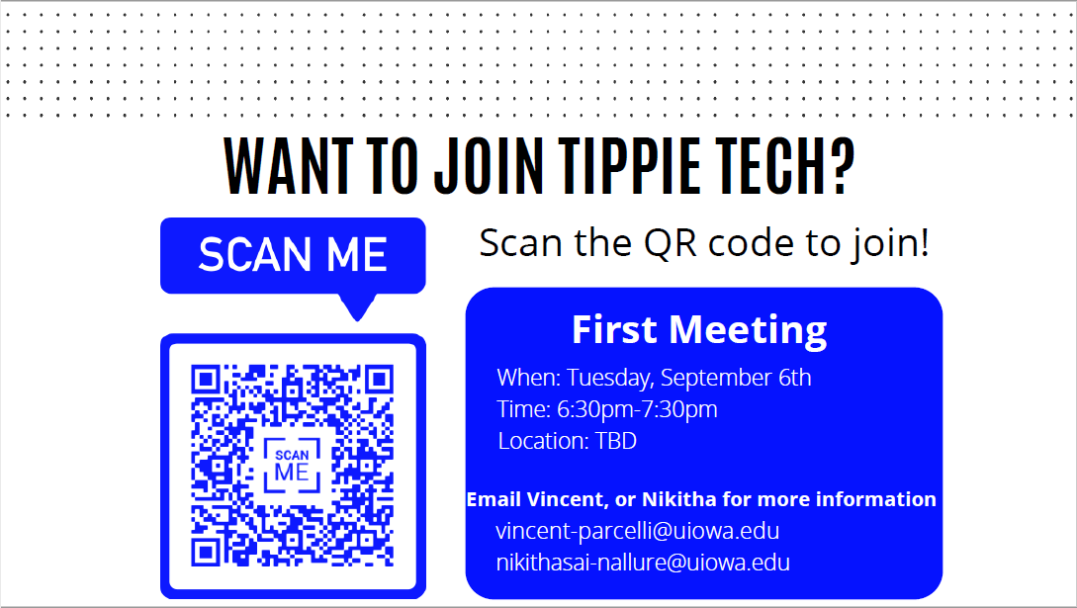

Slide 5
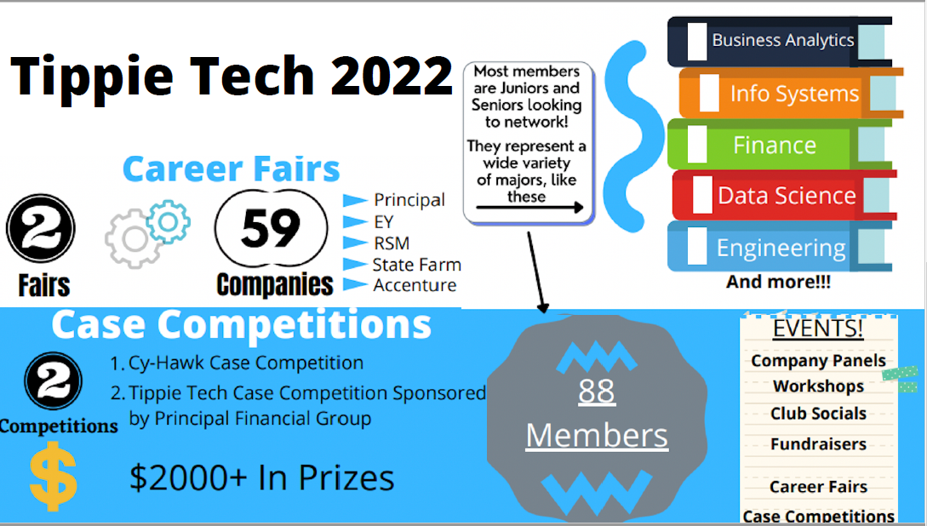

Slide 6

Pomerantz Career
Welcome Courtney McClellan
Assistant Director, Employer Engagement Events & Career Coach, Pomerantz Career Center C300 Pomerantz Center
Courtney-mcclellan@uiowa.edu

Slide 7





Upcoming Career Fairs
NOTE: Tippie Tech Virtual Career Fair: Wed. Sept. 21nd

Slide 8

Career Fair or Employer Prep
REGISTER for in-person AND virtual sessions
RESEARCH 5-7 employers to visit
2 you really like
2 that are ok
2 you don’t know
APPLY to company postings NOW
PRACTICE your introduction
BE CURIOUS and ask questions
FOLLOW UP - Get a business card, name, email address

Slide 9
Creating Your Pitch
Basics of creating an elevator pitch

Slide 10
Introduction Pitch Outline
Step 1: Who are you
Create an opener using your name, year and what you are studying
Step 2: What makes you interesting or unique
Write down quick phrases that describe essential bits of information you want to tell someone about you
Narrow down to 2 – 3 points
Step 3: What’s in it for the listener or what’s the ask?
What information is helpful for the listener?
Why do they want to talk to you further?
How can you help them?

Slide 11
Super Simple Introduction Layout (For the Beginner)
No idea what to do?
No background information on the company?
Start here with the most basic format:
My name is… (1)_state your name__,
I am a… (2) _year and major________
With an interest in… (3) _what is your area of interest within BAIS, Marketing, Finance, Accounting, so on_______.
Recently, I… (4)_did some interesting work, accomplished something fascinating, researched something in a school project, participated in something relatable to the career.
I am….(5) _skilled in this way – some soft skills and descriptor words (ex. Detail oriented, organized, a great communicator)
(Connection),….. (6)_give them something memorable if this feels comfortable _
I am looking for…(7)__full-time, internship and in what types of roles, or interest areas.

Slide 12
Super Simple Template Intro - Work Experience
Hello, my name is Kristine Arens. I’m a senior studying Business Analytics and Information Systems in the Tippie College of Business. I have taken an interest in creating amazing visualizations and data graphics.
This past summer, I created a dashboard for an investment company that allowed users to see key investments all on one screen. The company liked my solution so much they launched it nationwide. The dashboard was a great way for me to show off my skills as a diligent and detail-focused professional. I strive to create the highest quality solutions possible.
I am looking for a full-time role where I can apply my data visualization skills in an artistic way to tell a story within your company. I see ACME Logistics has a data intelligence analyst opening. Can you tell me a little more about the role?

Slide 13
Super Simple Intro – Project Experience
Hello, my name is Kristine Arens. I’m a junior studying Business Analytics and Information Systems in the Tippie College of Business, with an interest in database management.
Recently, I worked on a project that involved my love for the National Park system. I created a MySQL database where I loaded 75 years of park service data. From there, I selected and manipulated the data to evaluate if there were correlations between the number of park visitors and the US economy.
This is just one example of how I take pride in being a detail-focused professional, and I strive to create the highest quality solutions possible.
I am looking for an internship role where I can apply my database skills within your company. I noticed you had a data engineering internship position and I was wondering if you could tell me about the role?

Slide 14
Advanced Introduction Pitch (Version 3)
Hello, I’m Kristine Arens, a graduating Business Analytics student. I’m looking to join a team where I can apply my data visualization skills to improve customer product knowledge, and bring data to life through graphics.
This past summer, I interned at a consulting firm where I worked with a team of analysts, data scientists, and software engineers to create a system that would evaluate consumer purchase trends. I created visualizations, such as graphs and heatmaps that tracked these trends which gave leadership an easy way to evaluate which products were trending.
I saw your posting in Handshake for a Business Intelligence Analyst. In that role, it mentions you are looking for someone who can build industry reports and surveys using Tableau. Based on your needs, my skills and previous industry experience would be a great fit.
Could you tell me about your ideal candidate?”

Slide 15
Beginner GitHub

Slide 16

What is GitHub
A really cute cat octopus?
Open-source repository for storing software code
Allows tracking of iterations (version control)
Collaboration tool
AND…A GREAT WAY TO SHOWCASE YOUR SKILLS TO EMPLOYERS

Slide 17
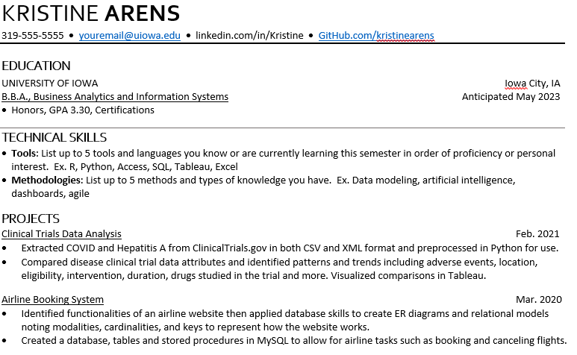
GitHub on Resumes
Showcase your work
Match repository to projects
Provide:
Code examples
Presentations
Data Analysis

Slide 18
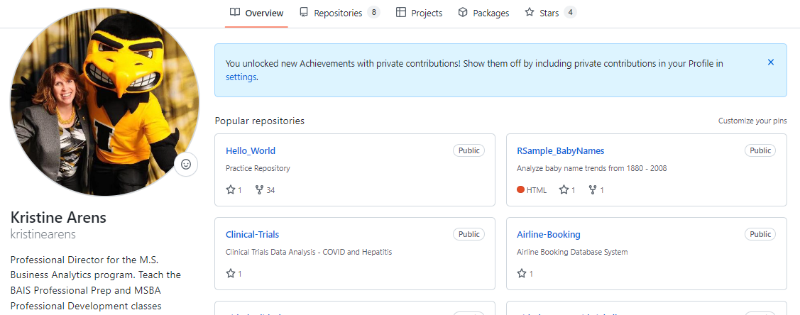
Let’s Take a Look
https://github.com/kristinearens

Slide 19
Thinking Ahead – Mock Interviews

Slide 20

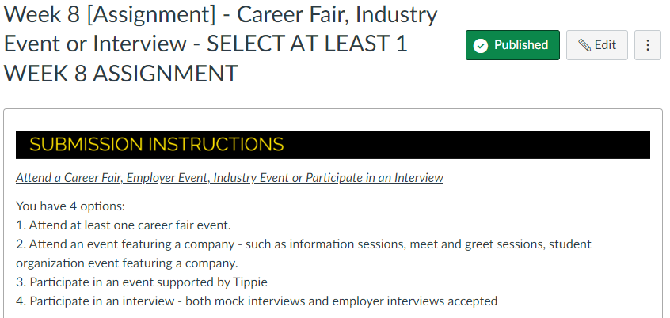
Mock Interview Assignment News
Mock Interview – Sign up NOW in
Select Jobs
Search for “Mock” or “Mock Interview”
Apply to the posting and you will be allowed to select a timeslot
This can count toward the Week 8 Assignment: (25 points)

Slide 21
Next Week!

Slide 22
NEXT ASSIGNMENT: Career Resources and Tools
Review the information shared by PCC
Take the Quiz
I’ll get this quiz published today!
DUE: Thur. Sept. 8th @ 11:59pm

Slide 23
Next Week – Technical Resumes
Technical Resume Overview
BRING YOUR COMPUTER AND RESUME
Applicant Tracking Systems

Slide 24
Questions?

